Slide 1
New Topic: Probability Probability Expressions
Year 12 Essentials

Slide 2
5 Questions

Slide 3
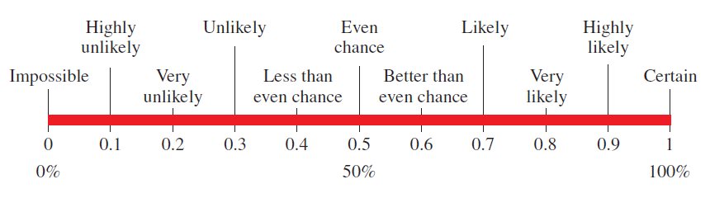
24
7
30
Probability Expressions
Date
EQ – What language do we use to describe probability?
Probability:
is the chance of an event occurring
may be written as percentages, decimals and fractions
An event is something that might happen (e.g. rolling a 6 on a 6-sided die)
A scale is used to describe the probability of an event happening
Probability Expressions

Slide 4
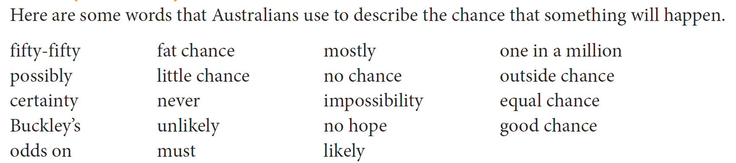
Group Activity
Certain or Very Likely to Happen Could Happen Won’t or very unlikely to happen

Slide 5
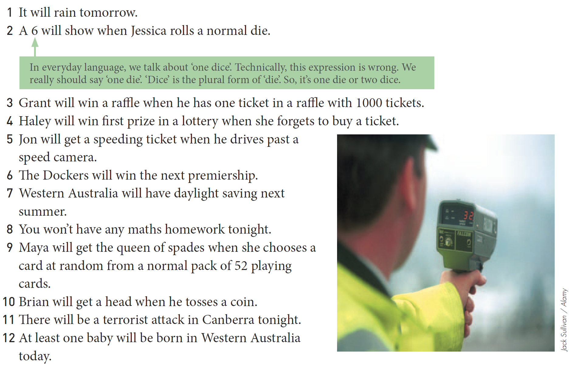
Practice

Slide 6

24
7
30
Probability Expressions
Date
EQ – What language do we use to describe probability?
Probability Expressions
Probability can be expressed in a mathematical way:
based as a faction of the number of favourable outcomes to the number of possible outcomes.

Slide 7

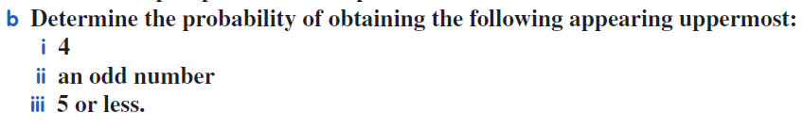
Practice

Slide 8


Slide 9
